Slide 1
Docker - Build Custom Image
Hung.Tran

Slide 2
CONTENT
Create docker image
Dockerfile teadown
What is a image base
Build process in detail
Docker compose
Rebuild docker compose
Restart policies
Run an example (nodejs application)
Build an example: a counter visit to website

Slide 3
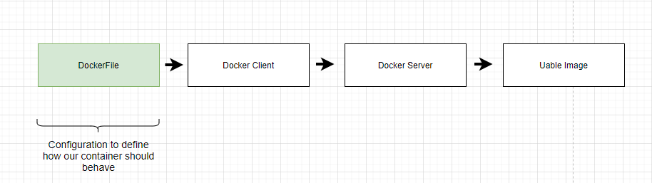
Create Docker Image
Notes:
Docker files is a plain text that have a couple of line of code of configuration placed inside of it.
That configuration is going to define how the container behaves or more specifically, and what is does when it start up as a container.
When the docker file create then the file will pass to Docker Client, which you will recall the Docker CLI using the terminal, and it will provide the file to Docker Server
The Docker Server to look all line of code of configurtion that have inside, and than build a useable image that can be use to create a new container

Slide 4
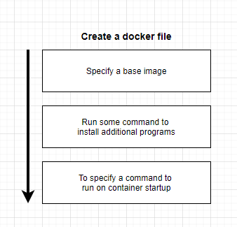
Create Docker Image

Slide 5
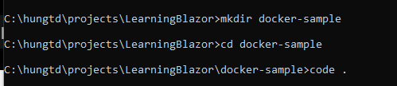
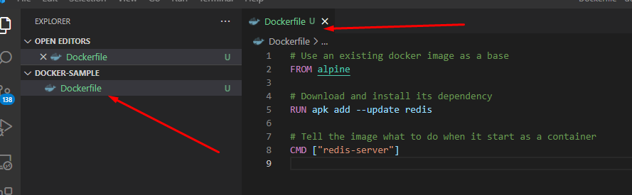
Create Docker Image
Create folder and start vs code to create Dockerfile
Notes:
Create a folder to store docker file
run vs code and create Dockerfile and add some commands into it.

Slide 6
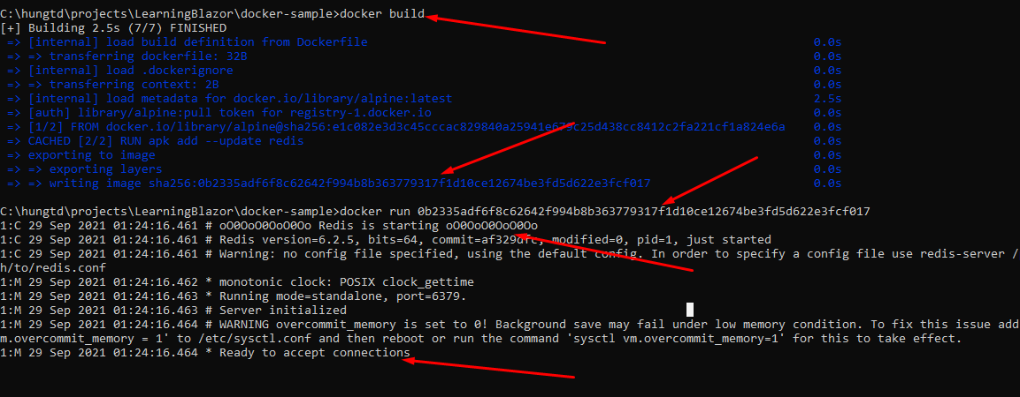
Create Docker Image
Build and run docker file

Slide 7
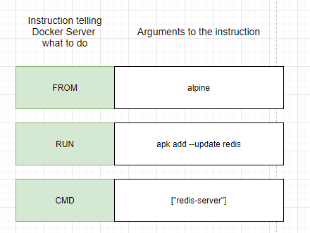
Dockerfile teadown
Notes:
FROM: used to specify the image that we want to use as a base
RUN: used to execute some command while are preparing our custom image
CMD: What should we executed when our image to start up a branch new container

Slide 8
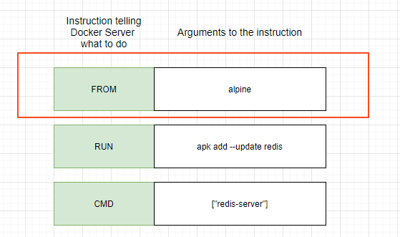
What is a base image?
A base system operation can be windows, MacOS, Linux
It enough dependencies to run an application

Slide 9
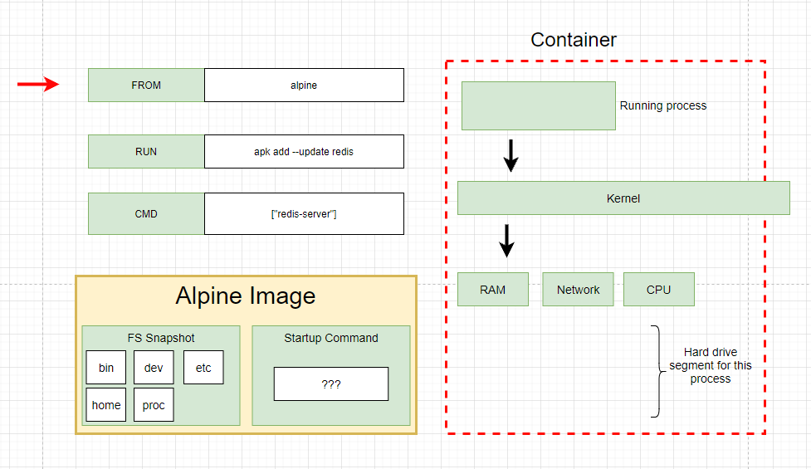
Build process in detail
Step 1: Run “FROM alpile”, download image from Docker Hub and create an image

Slide 10
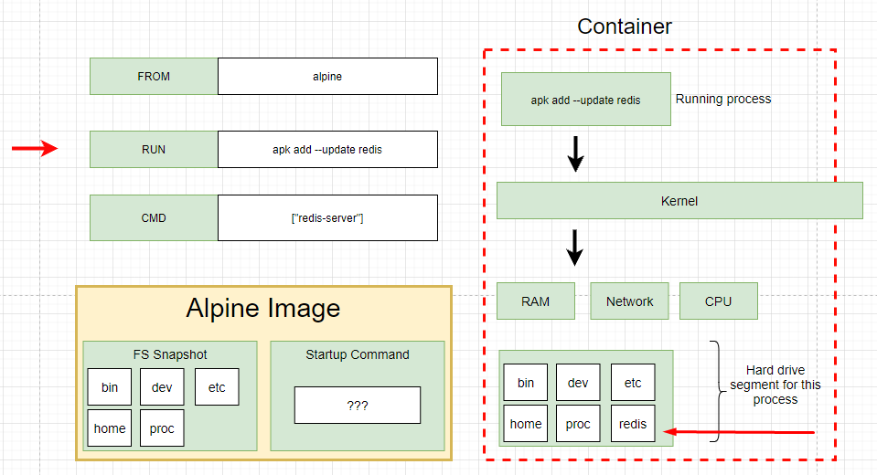
Build process in detail
Step 2: Run “RUN apk add --update redis”, Use image from step 1 and create new temporary container and download redis

Slide 11
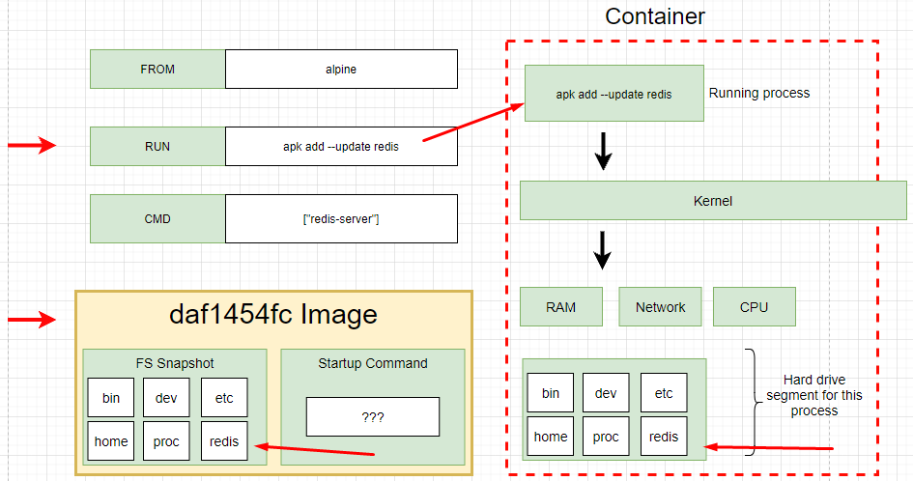
Build process in detail
Step 2: Run “RUN apk add --update redis”, Use image from step 1 and create new temporary container and download redis.
Remove the current temporary container
Take a snapshot and save into new image

Slide 12
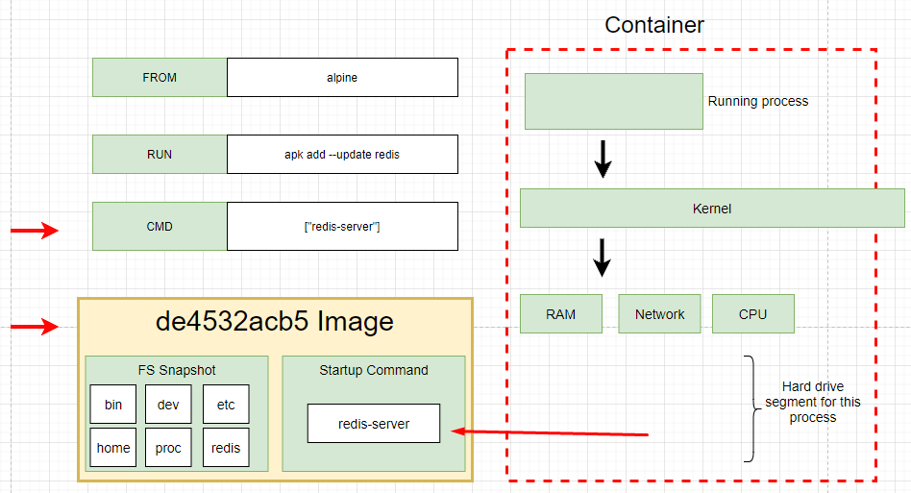
Build process in detail
Step 3: Run “CMD [“redis-server”]”, Use image from step 2 and create new temporary container and setting the primary command or primary process of container.
The primary command is the default command executed when container created.
Take a snapshot and save into new image

Slide 13
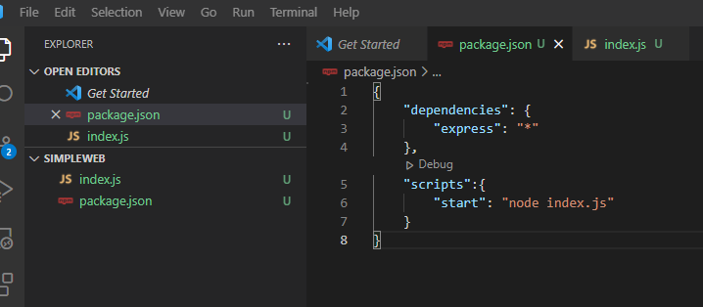
Build docker example (nodejs application)
Adding package.json file

Slide 14
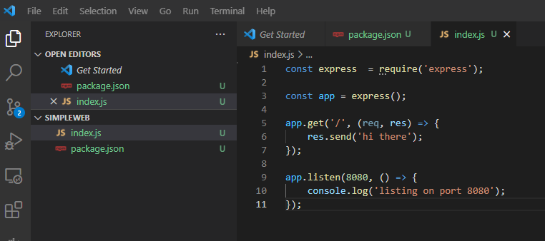
Build docker example (nodejs application)
Adding index.js file

Slide 15
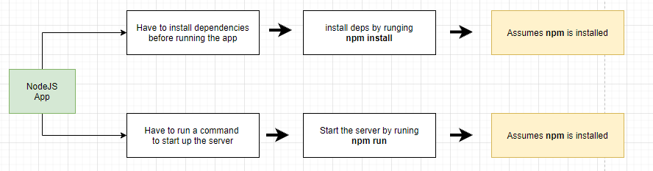
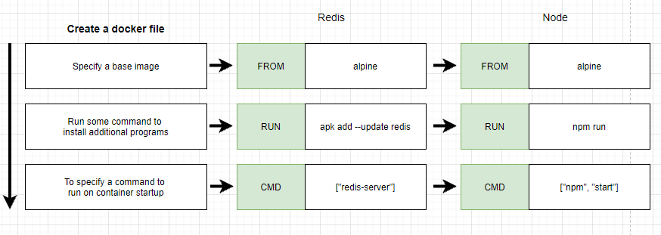
Build docker example (nodejs application)

Slide 16
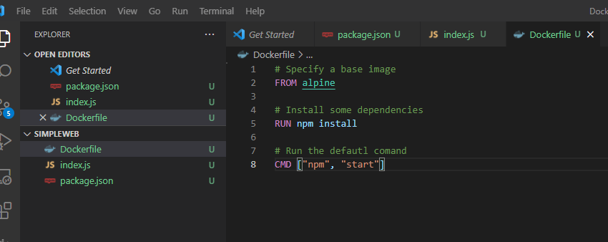
Build docker example (nodejs application)

Slide 17
Build docker example (nodejs application)

Slide 18
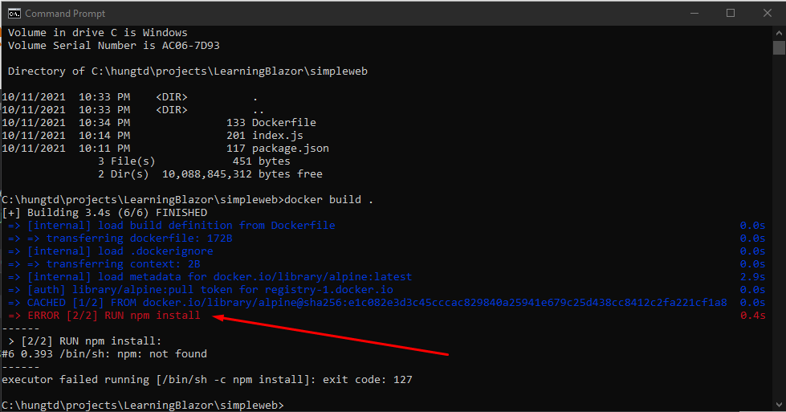
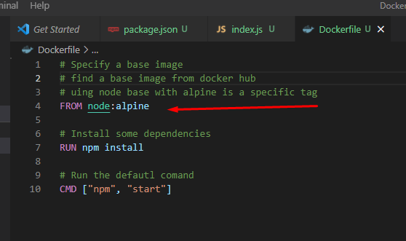
Build docker example (nodejs application)
RUN npm install not found
Solution 1: Find another image on Docker Hub including npm
Solution 2: Install more command to install npm

Slide 19
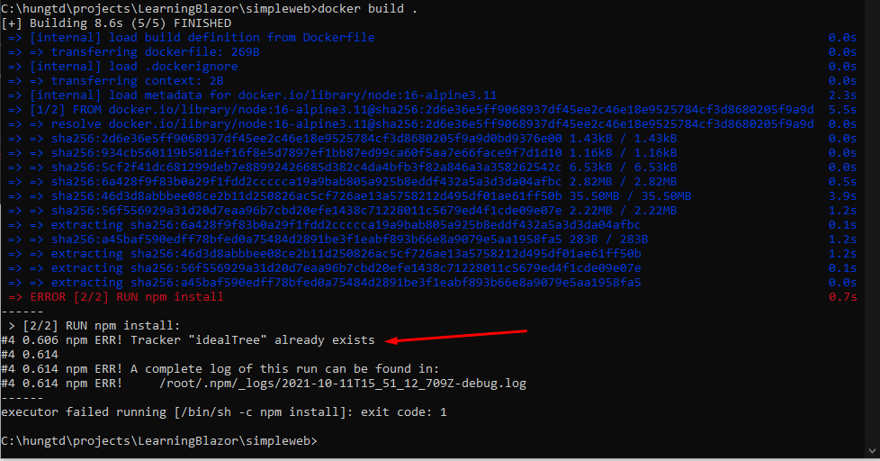
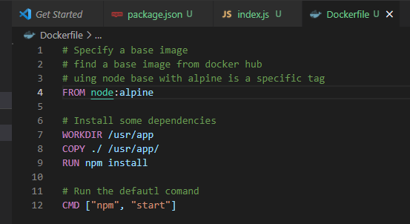
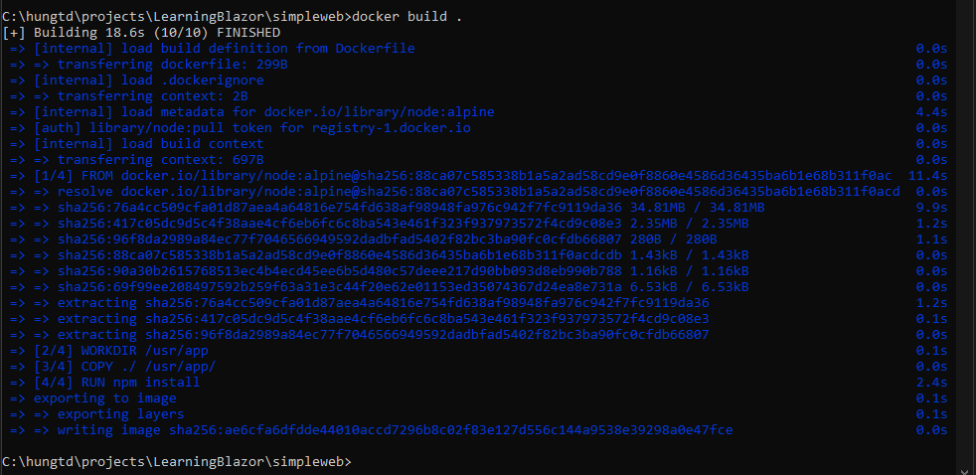
Build docker example (nodejs application)
npm ERR! Tracker "idealTree" already exists
This issue is happening due to changes in nodejs starting version 15. When no WORKDIR is specified, npm install is executed in the root directory of the container, which is resulting in this error.
Executing the npm install in a project directory of the container specified by WORKDIR resolves the issue

Slide 20
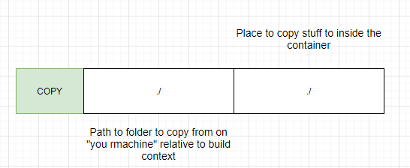
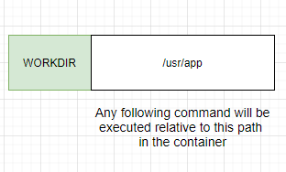
Build docker example (nodejs application)
Copy all files in the current build context folder to the folder inthe container

Slide 21
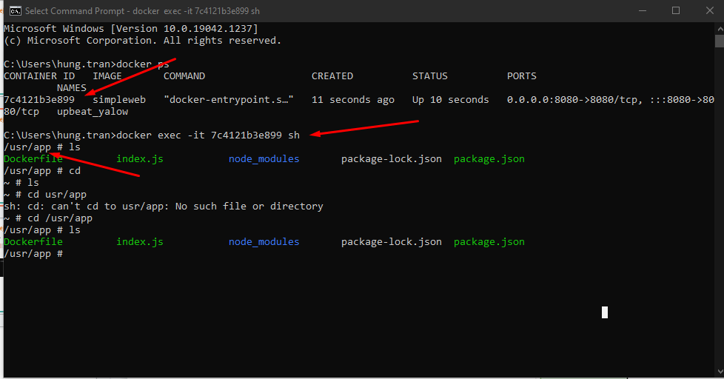
Build docker example (nodejs application)
Copy all files in the current build context folder to the folder inthe container
When run the container, the cursor point direct to the /usr/app directory

Slide 22
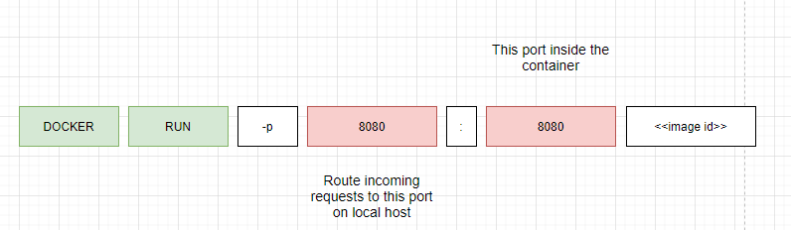
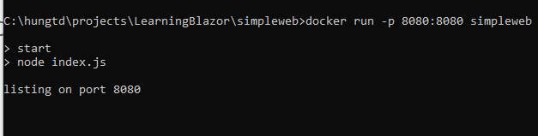
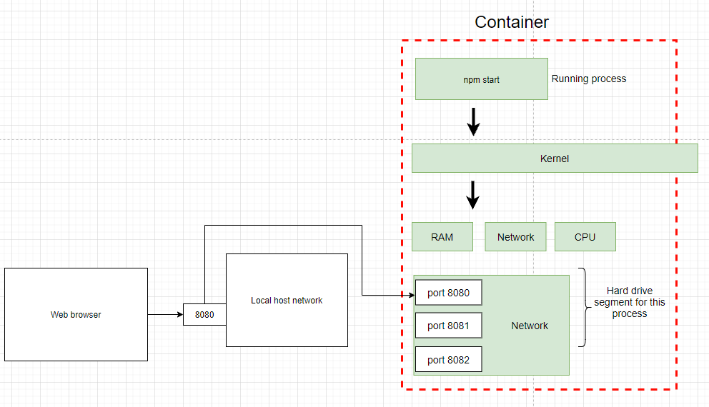
Build docker example (nodejs application)
Container port mapping and run in browser
Image’s Id or Image’s name

Slide 23
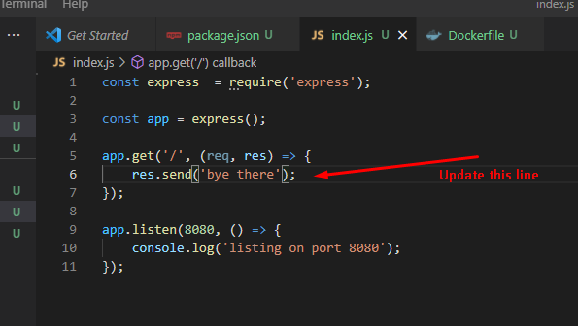
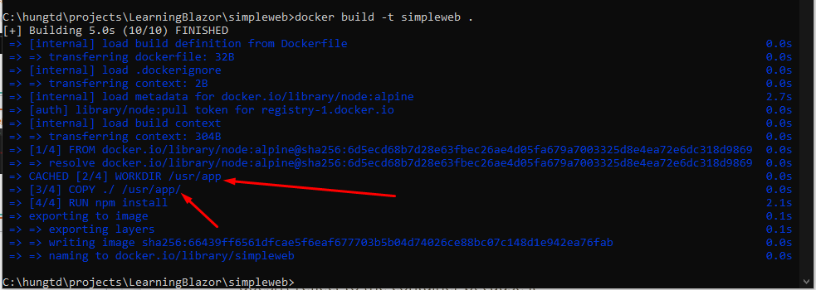
Build docker example (nodejs application)
When you update the file such as index.js. It doesn’t reflect to the container because it doesn’t copy snapshot to the container. We must rebuild manually.
While rebuild processing, Only the copy files are executed, other are execute from Cache

Slide 24
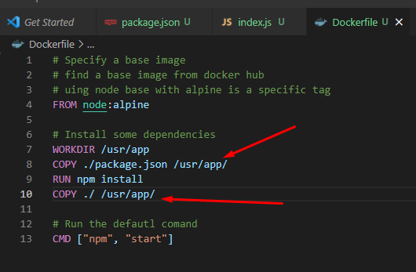
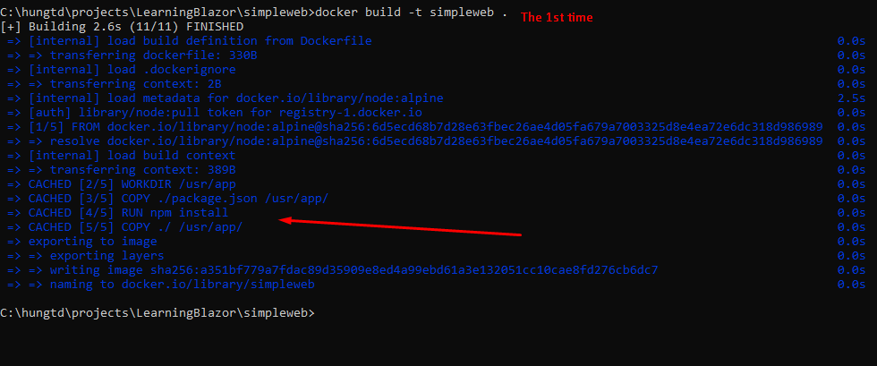
Build docker example (nodejs application)
The solution is copy the package.json before run npm install. It will cache this step and run from cache another time if don’t have any changes when rebuild the container

Slide 25
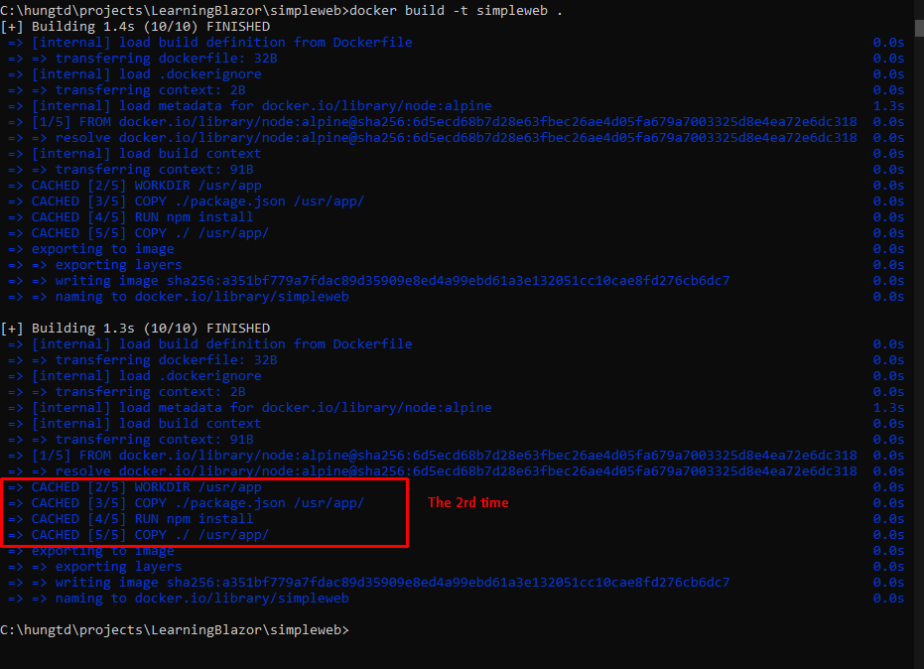
Build docker example (nodejs application)
The second time will execute from Cache. It help build faster in reality we have complicated process

Slide 26
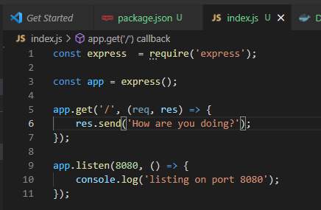
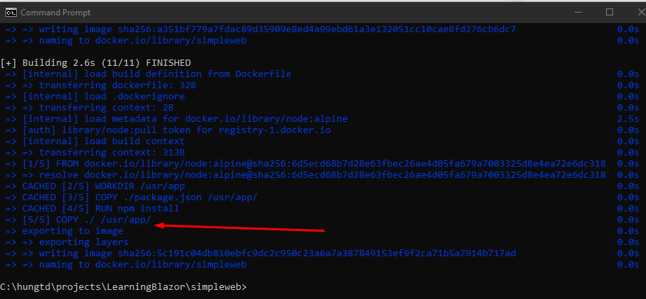
Build docker example (nodejs application)
We try to update index.js and rebuild again

Slide 27
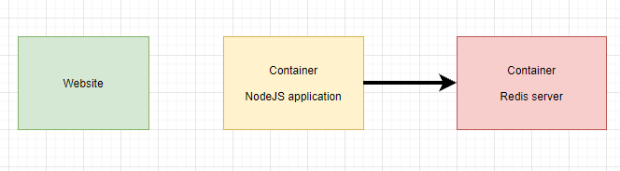
Build docker example (counter visit website)
Build a simple website run on nodejs and connect to redis server to save how many user access to the website

Slide 28
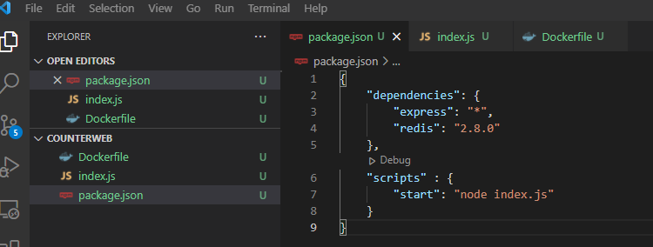
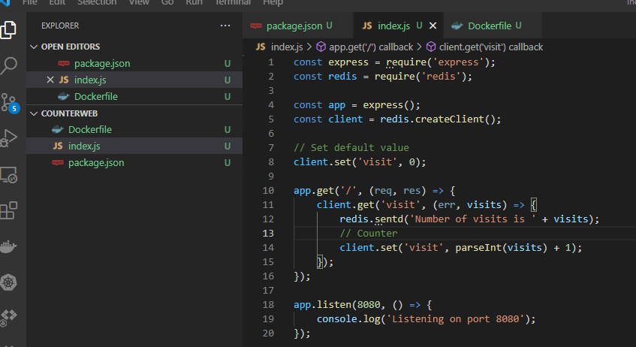
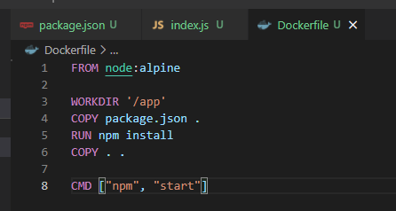
Build docker example (counter visit website)
Create new folder and build like these

Slide 29
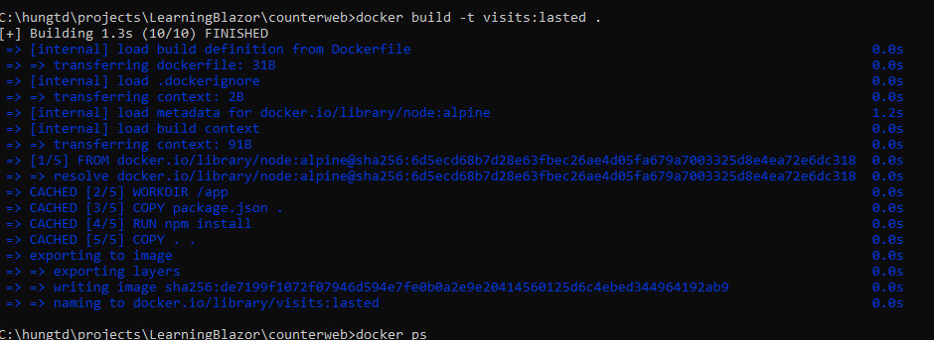
Build docker example (counter visit website)
Build an image with the tag name is visits:lasted

Slide 30
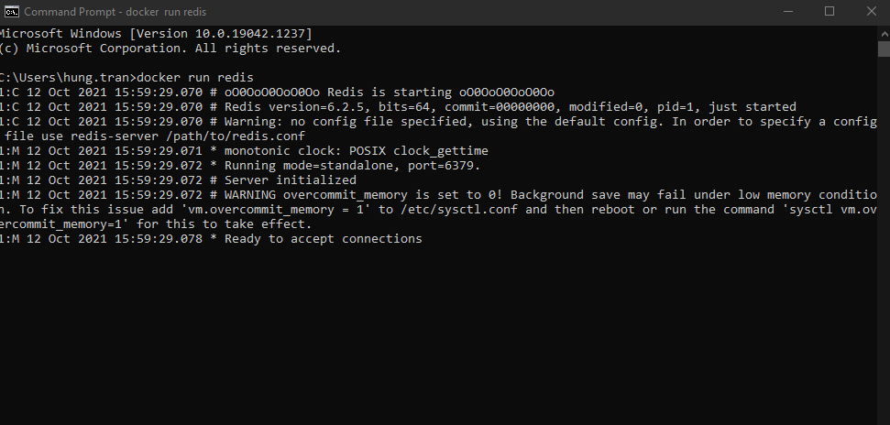
Build docker example (counter visit website)
Run redis server

Slide 31
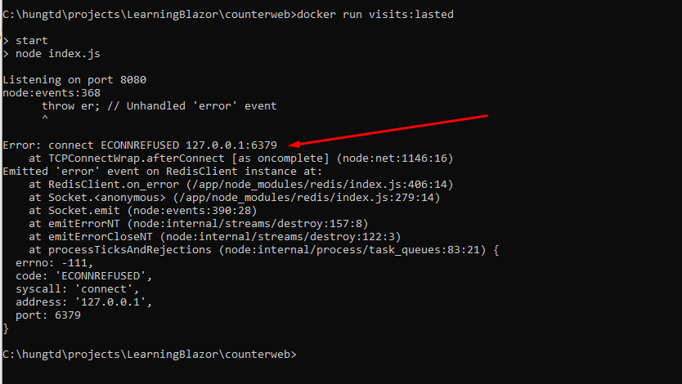
Build docker example (counter visit website)
Run node app
Get the error: can’t connect to redis server (the redis started)

Slide 32
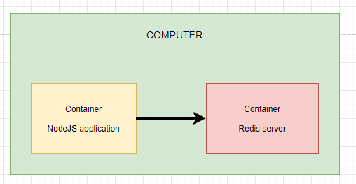
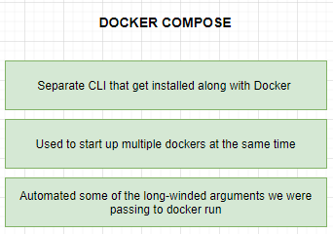
Build docker example (counter visit website)
In the computer, two container work independently. We have two options
1. Using Docker CLI network feature: It has a limit is we have to manual write a command to execute
2. Using Docker compose

Slide 33
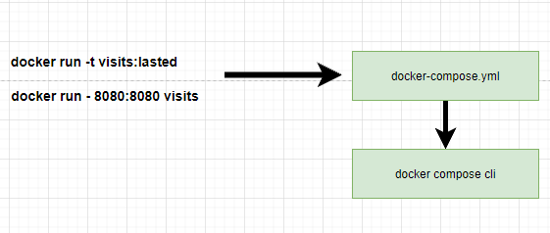
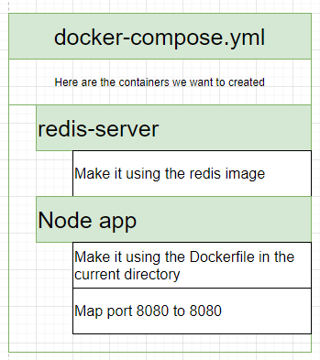
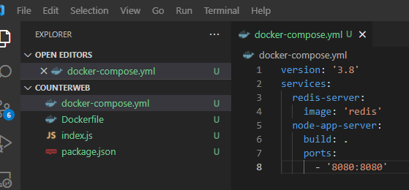
Build docker example (counter visit website)
Notes:
- We move the commands into the docker-compose.yml file which will be executed by docker compose CLI.
- services: means list of docker container you want to run

Slide 34
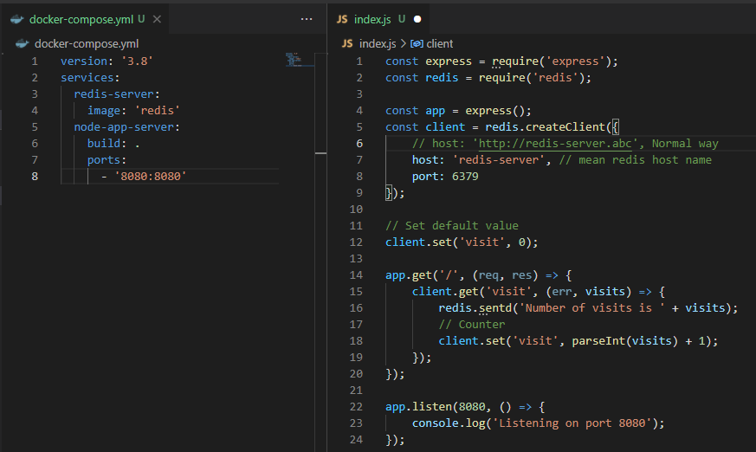
Build docker example (counter visit website)
Networking with docker compose

Slide 35
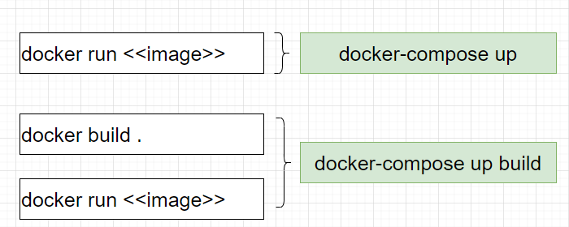
Build docker example (counter visit website)
Docker compose commands
Docker compose will read docker-compose.yml file to build the process

Slide 36
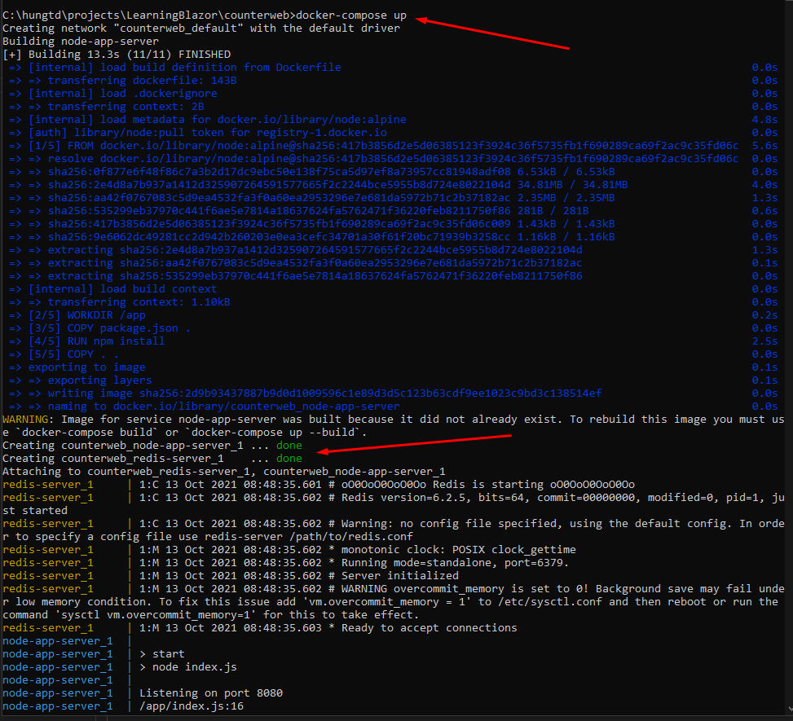
Build docker example (counter visit website)

Slide 37
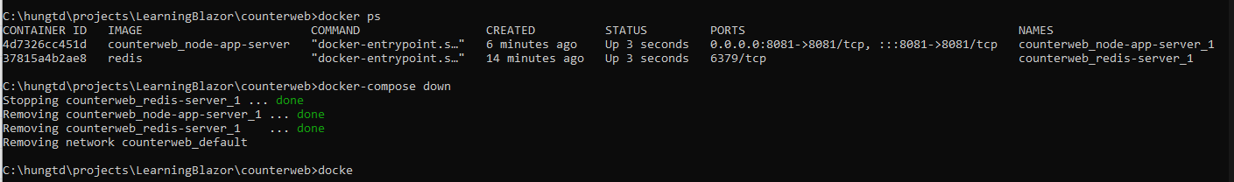

Build docker example (counter visit website)
stop docker compose

Slide 38

Build docker example (counter visit website)
rebuild the docker compose

Slide 39


Build docker example (counter visit website)
Maintaince the container in cases crash or error
Note: “no” is special case we must use with single qoute (‘) because if we don’t use it, docker yaml read as false.
Notes:
For some cases we must the docker always start like iis server so we need to set restart status is always

Slide 40

Build docker example (counter visit website)
docker-compose ps
Run in specific docker folder
If you run out of docker files folder, It throw an error message

Slide 42
THANKS FOR LISTENING

